Slide 1

HTU
HTU POS
System

Slide 2

Introduction
A Point of Sale System is necessary for almost all retail-based activities to accurately record customer and product activity. Every business owner wants to know which products sell the most, which customers purchase the most frequently, how much inventory is on hand, which payment method customers prefer

Slide 3
The Problems
1-Security vulnerabilities
2-Access pages by URL
3-Users access

Slide 4
Our Solutions
1- Using password hash, SQL injection
2- 404 error will show if somebody try to access pages by URL
3- Set permissions for users

Slide 5

Requirements Analysis
There will be five main pages(views):
1-Informative Dashboard.
2-Stocks management page.
3-Users management page.
4-Selling dashboard.
5-Transactions management page.

Slide 6
Requirements Analysis
There will be four users with different privileges to access previous pages:
1-Administrator: can access everything.
2-Accountant: can access only Transaction management page.
3-Procurement: can access only stock management page.
4-Seller: can access only selling dashboard.

Slide 7

Technology we used
Backend
Frontend
What we used
PHP
HTML
MySQL
CSS
Postman
JAVASCRIPT
AJAX
jQuery
Bootstrap

Slide 8






Tools we used

Slide 9
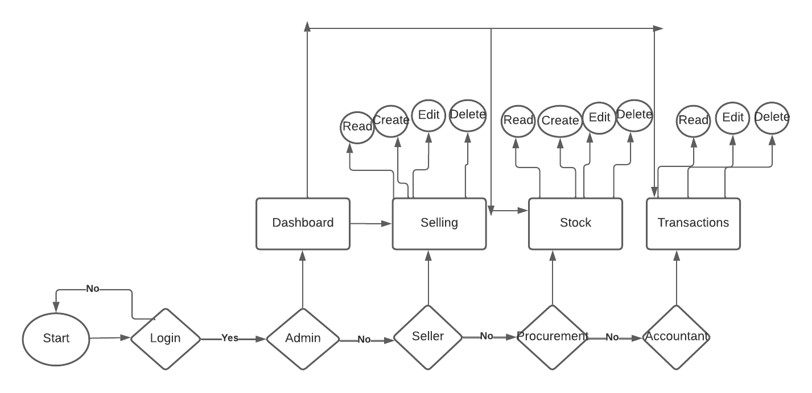
Work Flow

Slide 10

Thank
You

